Slide 1


Rural Cancer Detection & Patient Support Programme
Submitted By
ONCOSANJEEVA Welfare Foundation
(Section 8 Non-Profit Organization Registered Under Companies Act 2013)
CIN: U88900WB2025NPL285418
PAN: AAECO9943R
NGO ID: WB/2026/0960925
Head Office:
Karimpur, Nadia – 741152
Email: mca.oncosanjeeva.2025@outlook.com
Contact: 9609241259

Slide 2

Introduction
  ONCOSANJEEVA Welfare Foundation is a Government Recognised Section 8 Non-Profit Organization working for cancer prevention, early detection and cancer patient support in rural areas.
  The organization has previously conducted cancer awareness and screening camps in collaboration with Chittaranjan National Cancer Institute (CNCI), Kolkata under the voluntary initiative "Ashar Alo".
  The foundation intends to continue this work in a structured manner with Government support.
  The project aims to provide early cancer detection, patient support and referral services in rural areas of Nadia and Murshidabad districts

Slide 3

Need Justification
  Rural areas of Nadia and Murshidabad districts lack proper cancer detection and patient support facilities.
  Most cancer patients have to travel nearly 200–250 km to reach cancer hospitals such as:Chittaranjan National Cancer Institute, Kolkata, Tata Memorial Hospital, Mumbai
  Due to financial problems, lack of awareness and transportation difficulties many patients fail to receive early diagnosis.
  Therefore there is a strong need for a Rural Cancer Detection and Patient Support

Slide 4
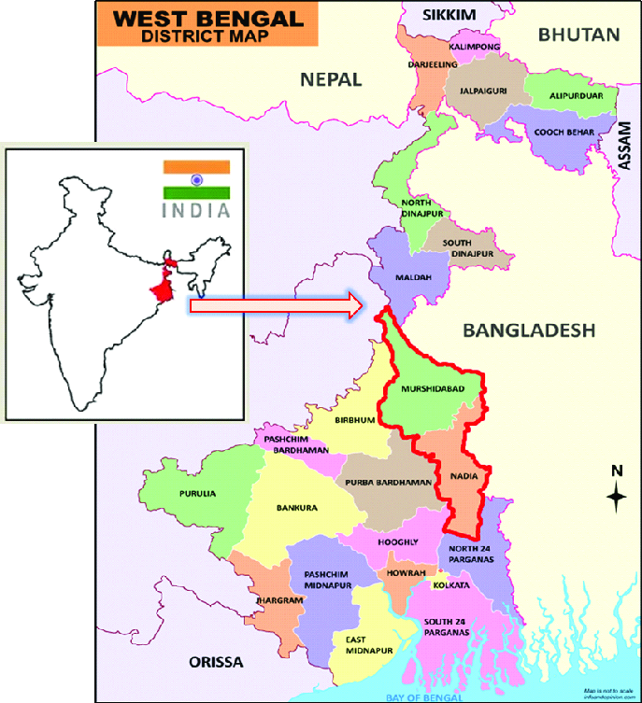
Project Area
The project Will be implemented in:
Nadia District
  Karimpur
  Tehatta
Murshidabad District
  Jalangi
  Domkal
This is a Multi-District Rural Cancer Programme.

Slide 5

Project Objectives
Primary Objectives
  Early Cancer Detection
  Cancer Awareness
  Free Patient Support
  Financial Assistance Guidance
  Regular Follow-up Service

Slide 6


Cancer Screening Services:
The following screening services will be provided:
  Breast Cancer Screening
  HPV Screening
  Cervical Cancer Screening
  Oral Cancer Screening
  Free Cancer OPD
  Monthly Free Cancer OPD will be organized.
Patients will receive:
  Specialist Doctor Consultation
  Follow-up Services
  Treatment Guidance
  Telemedicine Services
  Weekly Telemedicine services will be provided.
  Specialist doctors will provide consultation from Kolkata.
  Patient Support Services
Patients will receive support for:
  Hospital Admission
  Diagnostic Tests
  Treatment Guidance
  Follow-up Care
Project
Activities

Slide 7

Government Scheme Assistance
Patients will be assisted in availing financial support through:
  Ayushman Bharat PMJAY
  Swasthya Sathi
  Rashtriya Arogya Nidhi
  Health Minister Cancer Patient Fund
  Chief Minister Relief Fund
  Prime Minister Relief Fund
  Eligible patients including Bidi Workers will be assisted in obtaining financial support from:
Ministry of Labour Department Schemes

Slide 8
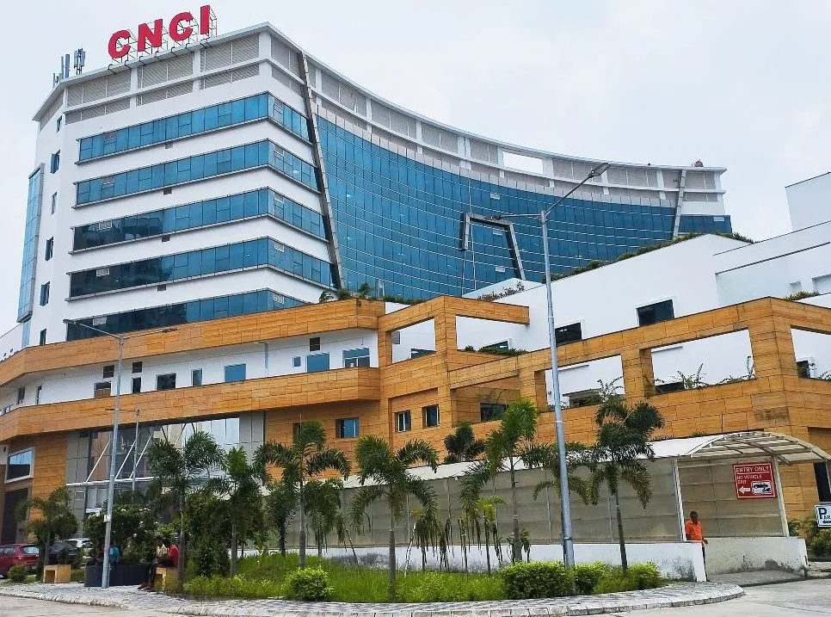


Referral Hospitals
Patients will be referred to:
  Chittaranjan National Cancer Institute , Kolkata
  Tata Memorial Hospital , Mumbai

Slide 9
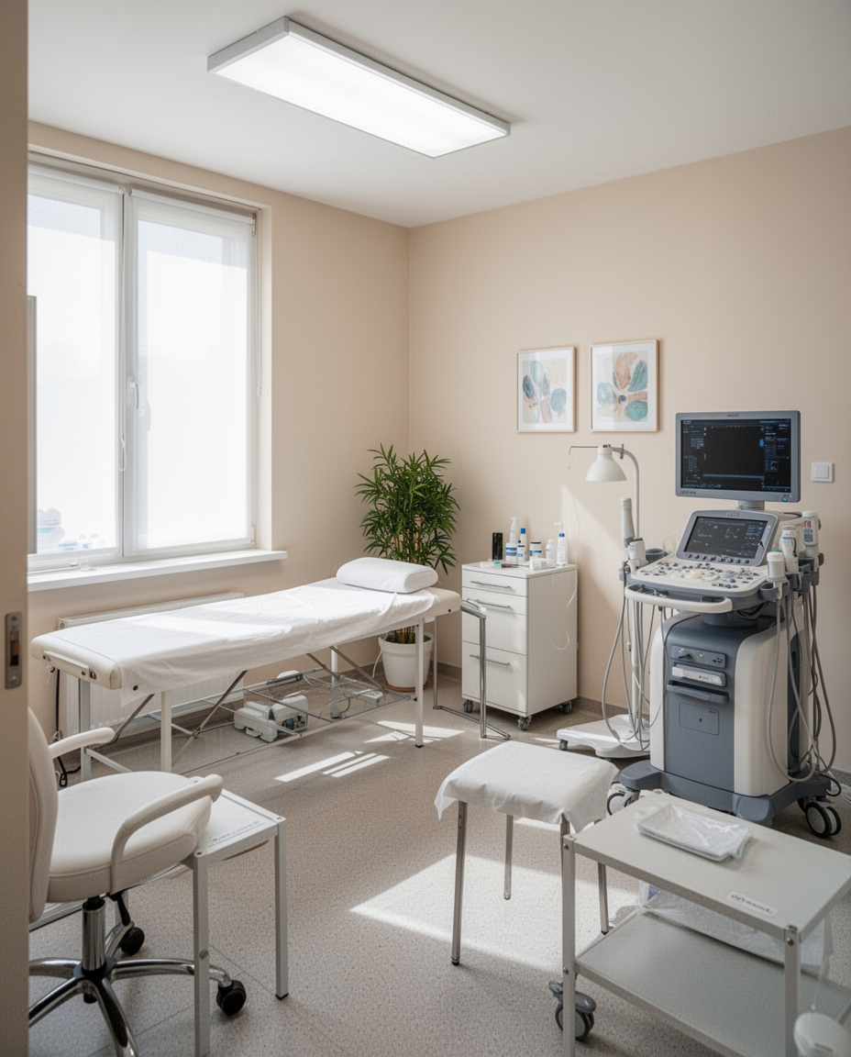
Establishing screening centers will ensure that rural communities have access to essential diagnostic services, enabling early detection of cancer and improving overall healthcare outcomes for patients.
.Infrastructure
Cancer Patient Support Centre
Room Rent:
₹5,000 per Month
₹60,000 per Year

Slide 10
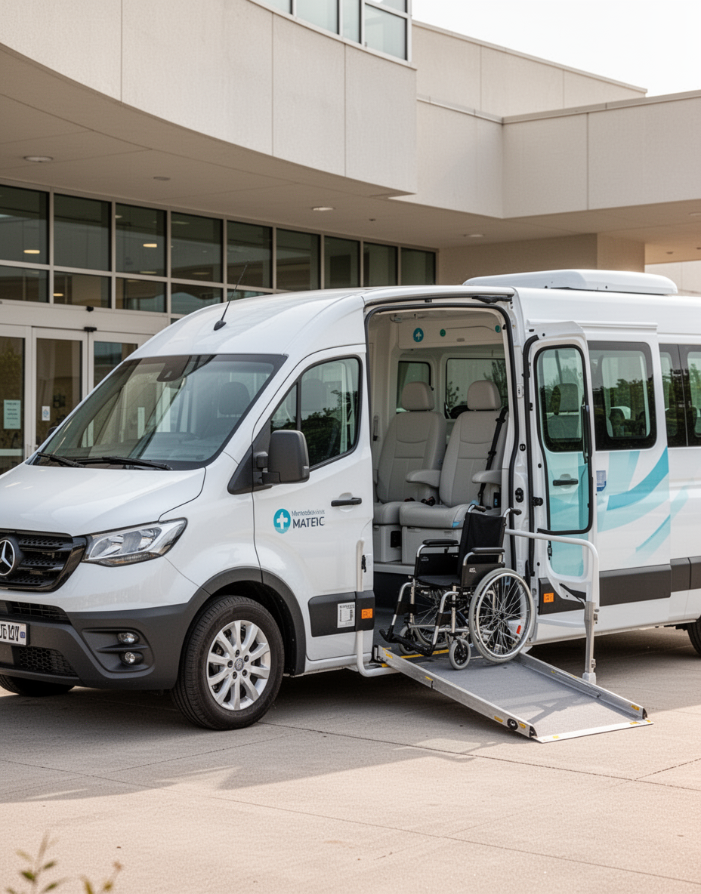
Transportation Assistance
We will provide transportation assistance to ensure patients can reach referral hospitals without any financial burden.
Transportation & Accommodation:
Doctor Travel from Kolkata to Project Areas
Approx 400 KM per visit
Transport + Stay + Food:
₹2,00,000 per Year

Slide 11
Implementation Plan
Monthly Activities
1 Free Cancer OPD Camp
1 Cancer Screening Camp
Weekly Activities
Telemedicine Consultation

Slide 12
Timeline
Month 1
Month 3
Month 6
Project planning and preparation for activities begin.
Implementation of screening camps for community members.
Follow-up care and evaluation of the program's impact.

Slide 13

Estimated Budget
  Cancer Screening Camps :₹3,00,000
  HPV Screening Kits:₹2,50,000
  Medical Equipment :₹1,50,000
  Awareness Programs :₹1,00,000
  Patient Support:₹1,00,000
  Transport & Accommodation:₹2,00,000
  Room Rent:₹60,000
  Telemedicine Setup:₹80,000
  Administration:₹1,00,000
  TOTAL PROJECT COST
  ₹13,40,000
The organization is eligible to receive tax-exempt donations under Section 80G, which ensures transparency and accountability in fund utilization.

Slide 14

Expected Outcomes
  The program aims for early detection of Cancer
  better treatment access,
  enhanced quality of life for all patients involved.
  Early Detection
  Increased Awareness
  Reduced Patient Delay
  Improved Rural Healthcare
  Support for Poor Cancer Patients

Slide 15

Legal & Statutory Credentials
ONCOSANJEEVA Welfare Foundation's registration details are essential for operational transparency and accountability in all activities.
CIN: U88900WB2025NPL28418
PAN: AAECO9943R
NGO ID (Darpan): WB/2026/0960925
12A Registration (Form 10AC)
URN: AAECO9943RE20251
Valid: AY 2026-27 to AY 2028-29
80G Approval (Form 10AC)
URN: AAECO9943RF20261
Valid: AY 2026-27 to AY 2028-29
CSR Registration Number : CSR00113374

Slide 16



Contact Information
For inquiries, please reach us at our contact number or visit our website for more details.
www.oncosanjeeva.org.in
mca.oncosanjeeva.2025@outlook.com
Contact:9609241259 ,

Slide 17
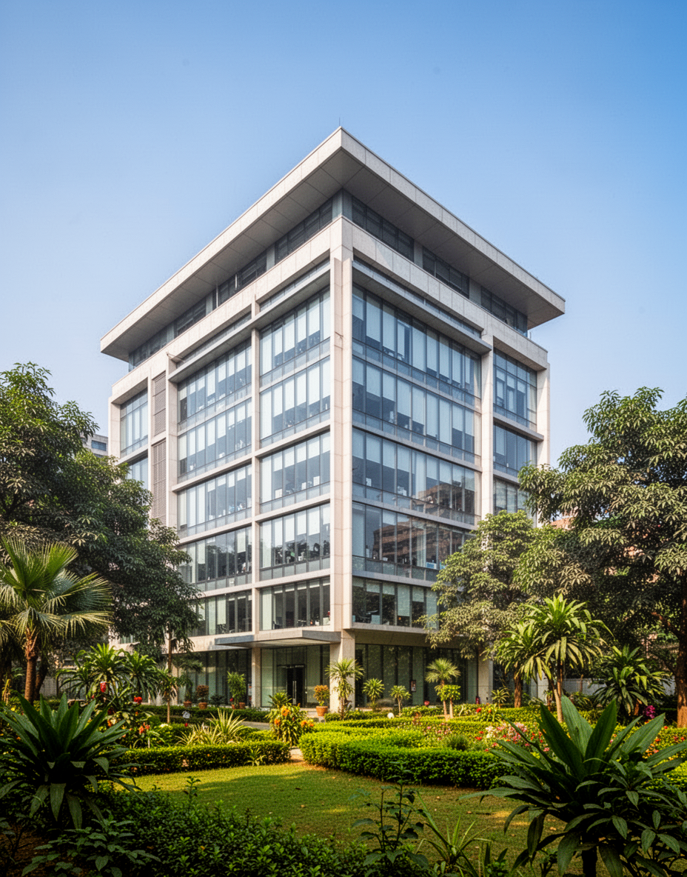
Head Office
The ONCOSANJEEVA Welfare Foundation is headquartered in Karimpur,Nadia , Westbengal, India,
PIN-741152

Slide 18


Thank You

